Slide 1
REBUILDING
Essential Housing
Request for Proposals
March 24, 2026

Slide 2
Essential Housing
Request for Proposals
Presentation Outline
Purpose
Background
Selection Criteria
Recommended Proponents
Legal Considerations, Financing, Ownership and Management
Recommendations

Slide 3
ESSENTIAL HOUSING RFP
Purpose/Background
Overview of the Essential Housing Request for Proposals (RFP) submission and selection process
Recommend that staff initiate contract discussions with two Proponents.
On October 28, 2025 Council directed staff to:
prepare for consideration, a Request for Proposal document for the construction of three units on Village owned property, notably 500 Fraser Street, 455 Fraser Street and 665 Station Road; and
explore legal considerations, financing and ongoing management cost related to the RFP process and ongoing ownership of the units.
On December 1, 2025, staff issued a RFP for small housing units to be constructed on three small lots owned by the Village. The RFP process closed on January 23, 2026, and resulted in the submission of 23 proposals and over 60 different designs.

Slide 4
ESSENTIAL HOUSING RFP
Intent
The intent of the RFP was threefold:
To provide the Lytton area rental housing units for permanent/full time essential service workers as outlined in the Interim Housing Strategy;
To provide new housing designs/contractors that might be desirable for other residents/property owners rebuilding in Lytton; and
To provide a catalogue showcasing the RFP homes that will be available for residents/property owners when selecting a contractor to rebuild their homes.
The BC Government has defined ESSENTIAL SERVICES as:
Daily services essential to preserving life, health, public safety, and basic societal functioning.
These include health care, emergency response, law enforcement, utilities, food supply, and more. The list was developed by Emergency Management BC in consultation with other ministries and the Provincial Health Officer.

Slide 5
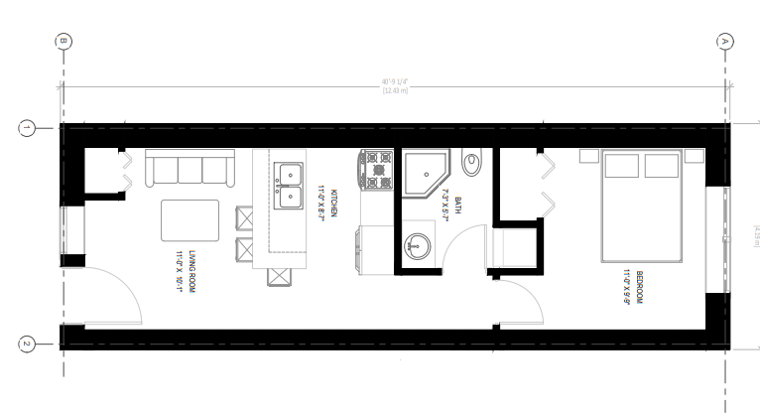

ESSENTIAL HOUSING RFP
Evaluation
STAGE 1.A - MANDATORY REQUIREMENTS
  The mandatory requirements resulted in only 13 of the 23 proposals proceeding.
  A challenge was the remaining 13 Proposals would also take considerable time to review in detail, particularly factoring in the construction specifications.
STAGE 1.B - EVALUATION CRITERIA
As permitted in RFP, staff added sub-stage focused on price and the number of buildable lots considering that the Village has limited funds.
only 500 Fraser Street and the Seventh Street road end (665 Station Road)
did not consider Proponents that had a price per square foot exceeding $400.

Slide 6
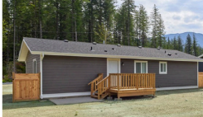
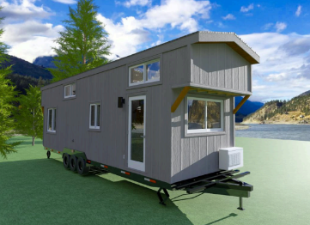
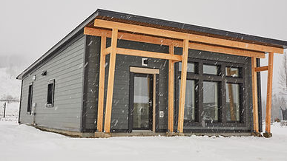
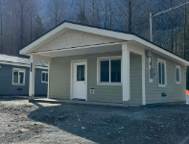
ESSENTIAL HOUSING RFP
Price and Spec Evaluation
STAGE 2.A - EVALUATION CRITERIA
ensure the price comparison is on a level playing field.
an array of housing construction types comprising traditional modulars, tiny homes, design/pre-fabricated modulars and design/build construction, with a considerable range of construction approaches, and varying quality and specifications.
Modular
Tiny Home
Design Modular
Design Build
    Important to compare the price and the unit specifications to ensure minimum needs of the Village and recognize the specification differences impacting price :
    type (no. of bedrooms)
    size (square foot) of the proposed units
    foundation type
    provision for a walkway and driveway; and
  quality of finishing.
NOTE THE PRICE AND SPEC EVALUATION WAS APPLIED TO THE OVERALL RFP CRITERIA IN CONSIDERATION OF PRICING.

Slide 7
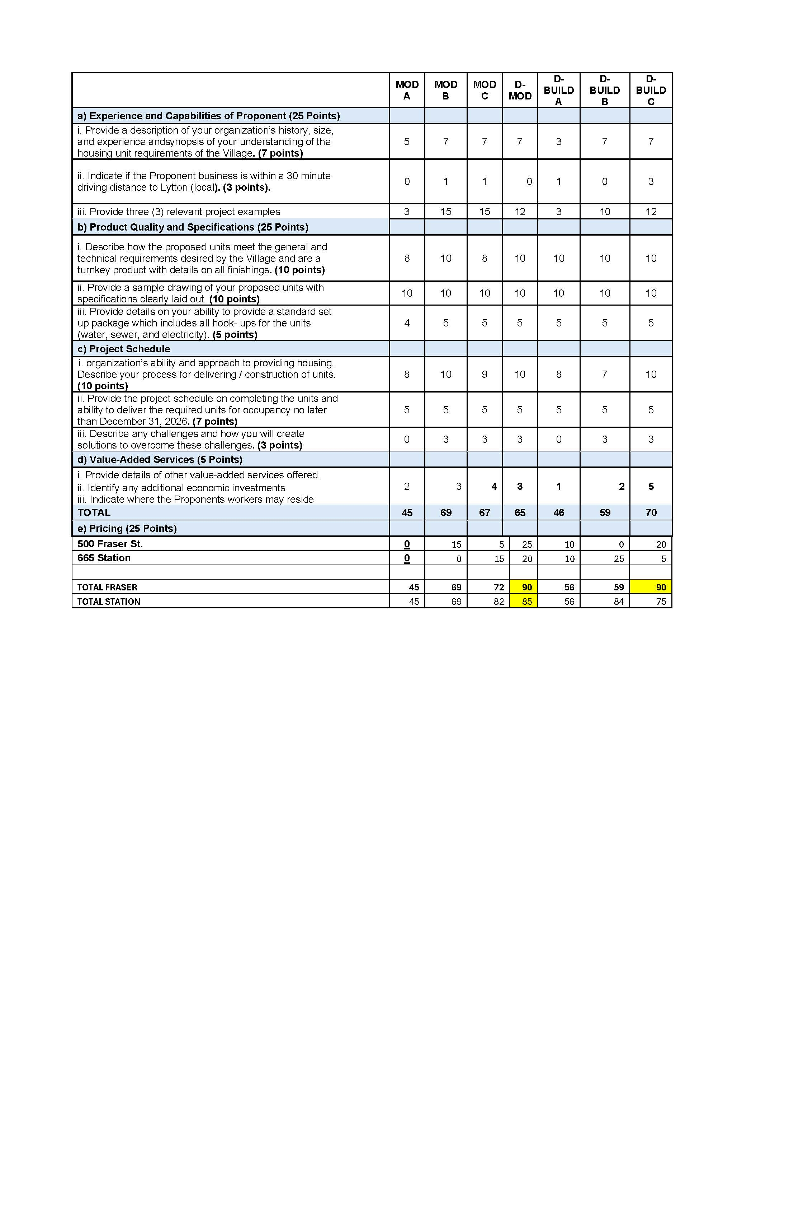
Evaluation Criteria Stage 2.B
ESSENTIAL HOUSING RFP

Slide 8


ESSENTIAL HOUSING RFP
Evaluation Criteria Stage 2.B
Note highest rated proponents differed slightly once the pricing was graded.
Lane One and South Pier had slightly higher price/sf but both were considered better value once construction specifications such as foundation type, driveways, and quality of finishes were compared and evaluated.
There was also consideration of whether the proposed dwellings were a"fit" for the neighbourhood. A large multi bedroom unit would fair better than a smaller unitas there are other factors impacted by the size of the dwelling including parking, landscaping as well as the total area and setbacks.

Slide 9
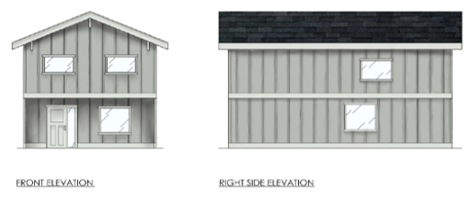
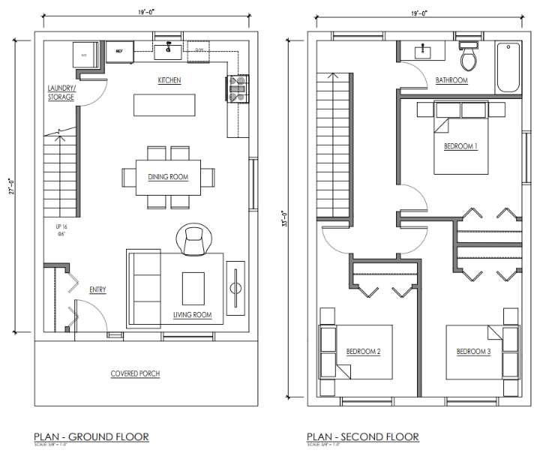
500 FRASER STREET
Proponent: South Pier
Frameworks
Three Bedroom
940 sf
2 storeys

Slide 10
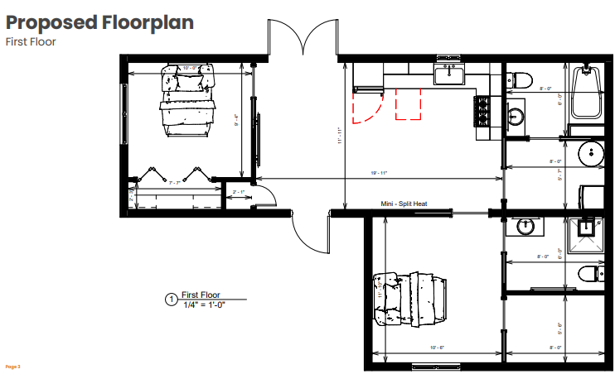
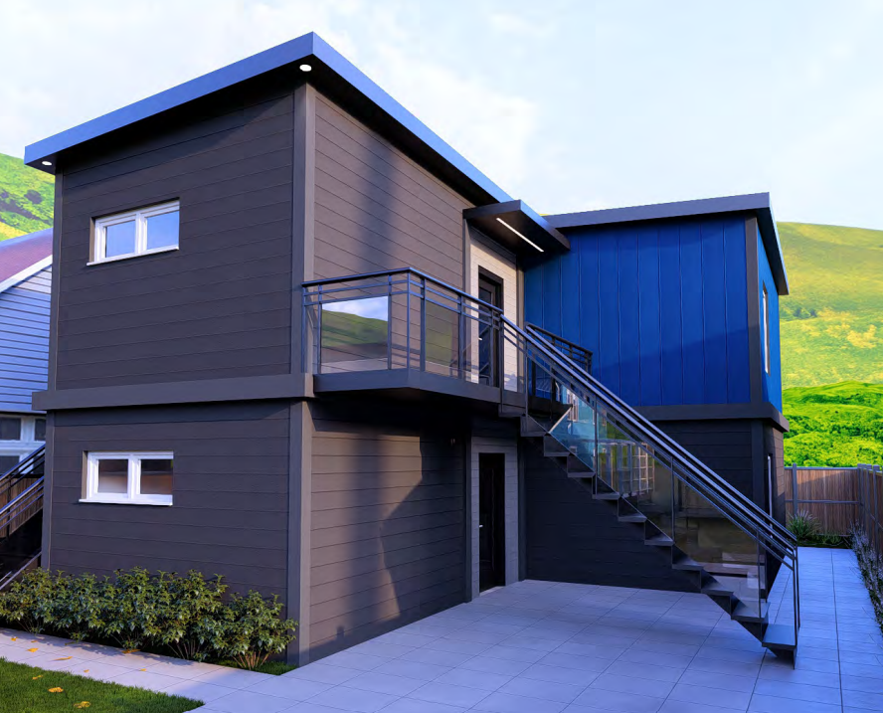
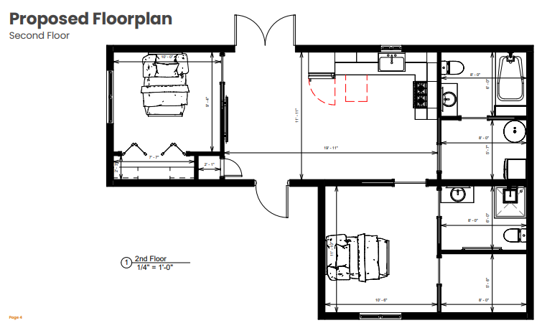
SEVENTH STREET ROAD END
(next to 665 Station Road)
Proponent: Lane One
Up/Down Duplex
2 x 2 bdrm/740 sf =1480 sf
2 storeys

Slide 11
ESSENTIAL HOUSING RFP
Final Evaluation
STAGE 3 – EVALUATION CONSIDERATIONS
References: Lane One and South Pier had excellent references.
Unit Type and Village Need:
Essential Housing RFP should prioritize family type units.
RFP Addenda stated…the Village is looking for 2-bedroom units (permanent essential worker accommodation) but realize that some of the lots are so small that this might not be possible. If this is the case 1-bedroom and studio options will be considered.…a two-bedroom unit on each of the three lots, any additional units or bedrooms would be a bonus…
Lane One proposing 2 x 2- bedroom units (740 sf each)
South Pier proposing a 3-bedroom unit (960 sf)
Contractors
Lane One indicated that the estimates are per property, there would be no cost increase if we were only selected for one of the properties.
South Pier indicated a 5% premium for only one home, but had value-added items

Slide 12

ESSENTIAL HOUSING RFP
Legal Considerations, Financing, Ownership and Management
Staff will bring back a report for Council consideration, specific to:
Final agreement with the Proponent and Village’s legal obligations
Financing of the full construction program
Ownership of the units
Ongoing management costs/rental rates
Staff will also commence work on the Showcase catalogue of design options from the RFP.

Slide 13
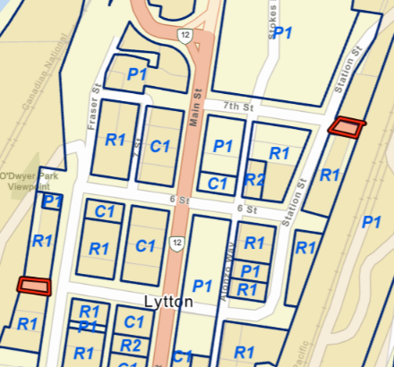
ESSENTIAL HOUSING RFP
Recommendations
THAT Council direct staff to commence negotiations for contracts with Lane One and South Pier to construct essential housing on Seventh Street road end (665 Station Road) and 500 Fraser Street, respectively.
THAT Council direct staff to commence the process to close a portion of the Seventh Street road end (adjacent to 665 Station Road) and bring forward a bylaw to rezone for low density residential;
AND THAT Council direct staff to bring forward a bylaw to rezone 500 Fraser Street to low density residential.

