Slide 1
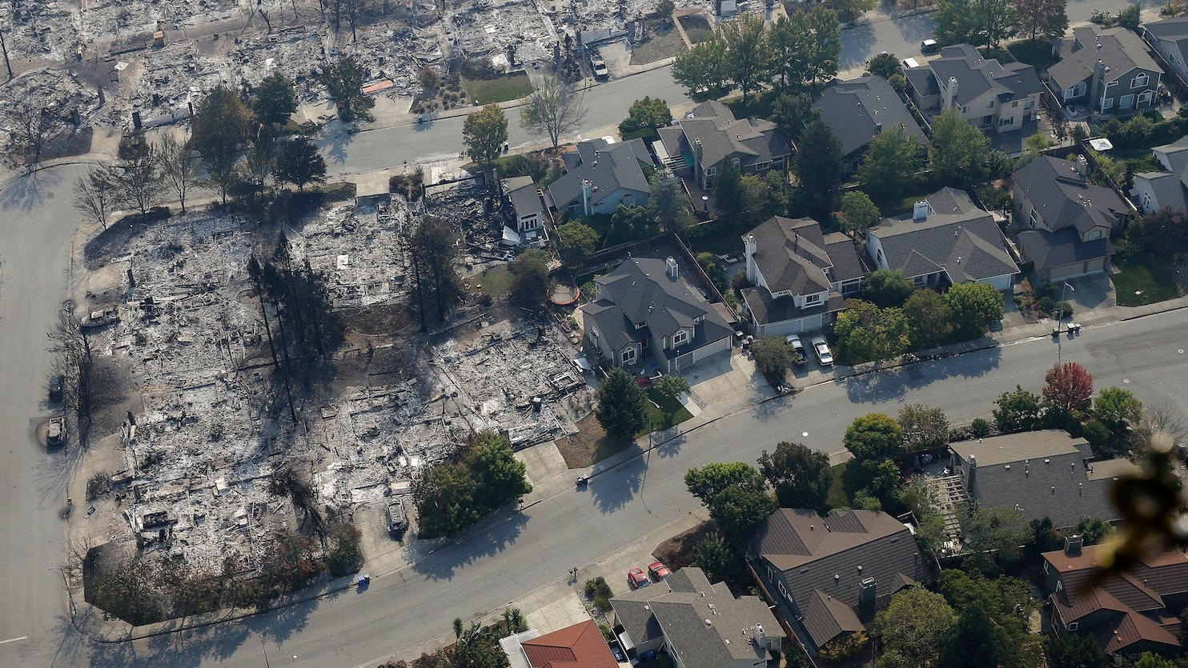

Wildfire Resistant Construction
RDH Building SCIENCE
February 15, 2024
Robin Urquhart | MBSc
Notes:
My name is Robin Urquhart. I work for RDH Building Science. We are primarily an enclosure engineering firm. So we deal with the outside of the building and the management of heat air and water. We got involved in wildfire resilient construction through a project that sought to rebuild a town in British Columbia called Lytton. In 2021, almost the entire town was burned down due to a wildfire. The previous day the town had set the Canadian high temperature record. Within an hour of the first fire call, the town was pretty much gone. Now people are moving back and thinking about rebuilding and we were asked by the Canadian government to provide support to a program for people to build wildfire resilient homes. We developed the recommendations and a checklist that homeowners who are engaged in the program have to meet. I also live in an extreme hazard WUI zone in BC and when we built our house we built it to be net-zero energy ready and to incorporate some wildfire mitigation design. Some people think it looks like a warehouse. I think it looks safe. The presentation I’m going to give is basically how to get from the red box to the green box.

Slide 2
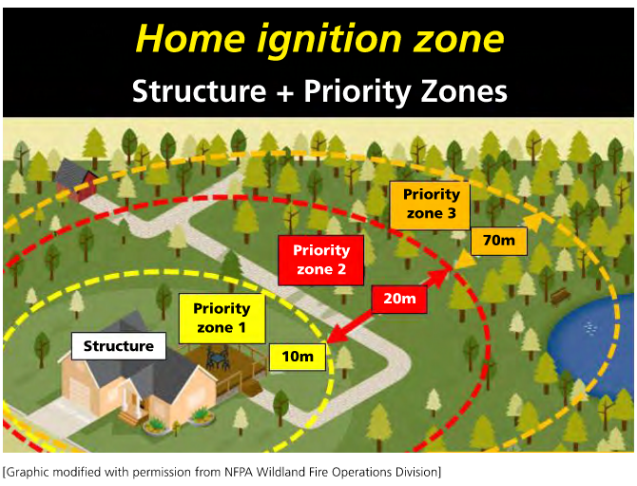
What is wildfire resistant (WFR) construction?
Not fire-proof
Reduces risk of structure ignition
Slows the spread of fire in a community
Reduces available fuel
Should be used in tandem with other mitigation measures
  Landscaping
  Fuel management
  Structured response
  etc

Slide 3
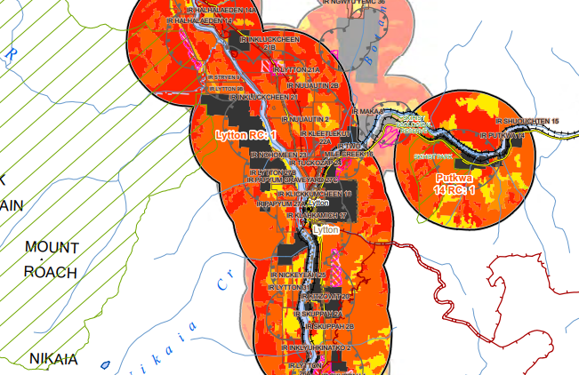
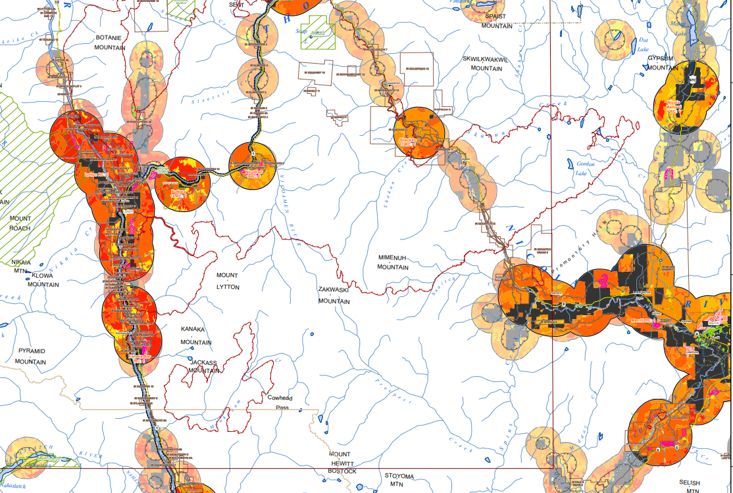
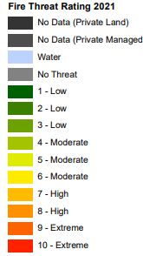
Why build wildfire resistant homes?

Slide 4
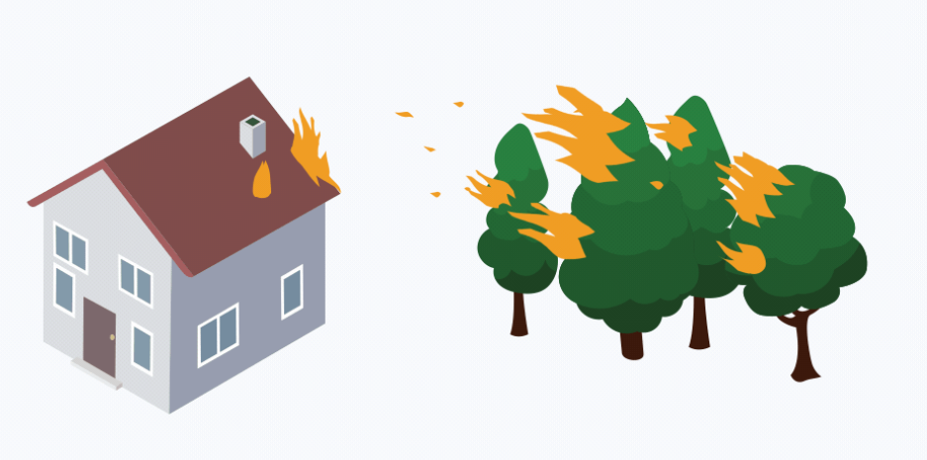
Why build wildfire resistant homes?
Embers cause up to 90% of structure ignitions
WFR construction reduces risk of structure ignition from embers and heat
Camp Fire (2018) - California
  51% homes survived (built after 2008)
  18% homes survived (built before 2008)
Key Finding (9) - An Examination of the Lytton, British Columbia Wildland-urban Fire Destruction, Cohen & Westhaver:
“For individual structures, and collectively, community ignition resistance is the most effective approach for reducing community wildfire risk and preventing WU fire disasters.”

Slide 5
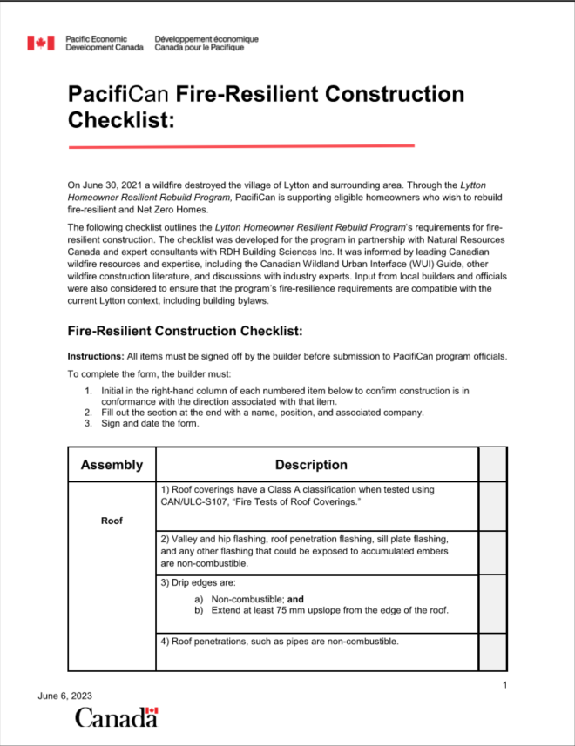
How do we build wildfire resistant homes?
Guidance
  PacifiCan Program/Checklist
  FireSmart
  NRC Guide to Wildland/Urban Interface
Mitigation measures
  Landscaping
  Roof material
  No gaps
  Fire resistant windows/doors
  Non-combustible materials
  Wildfire rated wall assemblies

Slide 6
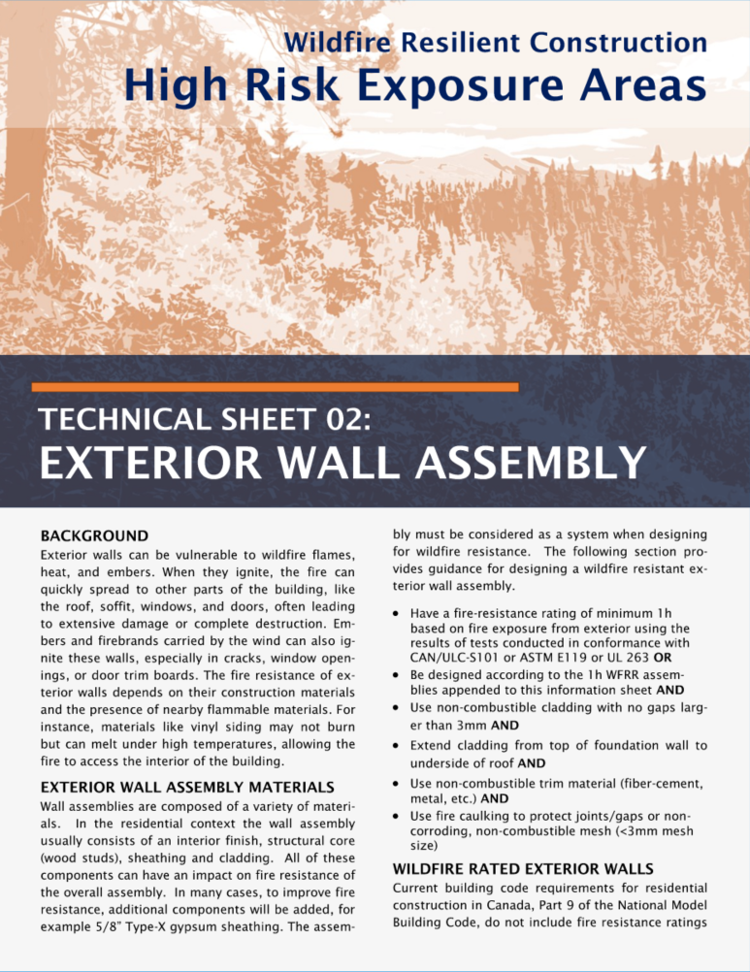
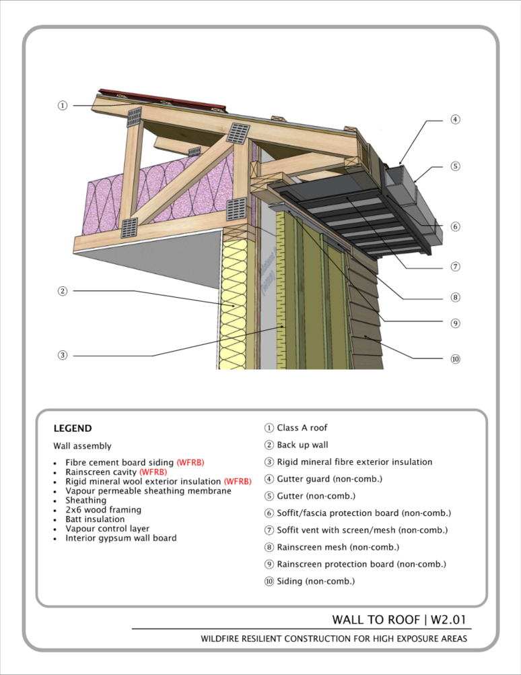
Support and Cost
Technical information sheets to support builders and homeowners
  Based on feedback from builders
  Provide engineered options for 1h Wildfire Resistant Rated (WFRR) exterior wall assemblies
  Funding
Additional cost estimated to be 10-15% of total build cost
  California average $20k
  Lytton costing estimate $26k
Cost sharing with net-zero (specifically exterior insulation) or higher end materials

Slide 7
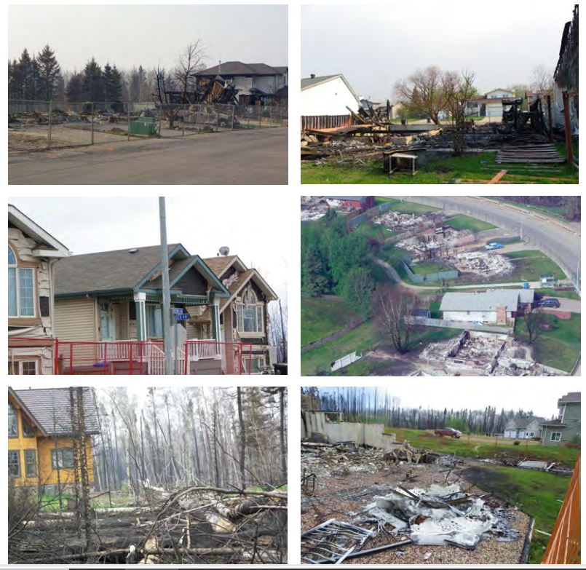
Recap
Best way to reduce wildland urban interface disasters it to reduce structure ignition
Wildfire Resistant (WFR) construction is effective in reducing structure ignition risk
Resources are available to support WFR homes
WFR construction is an additional cost, but can be paired with other measures
Not fire-proof – reducing risk, not eliminating it
Aftermath of Fort McMurray WU Fire Disaster

